Slide 1

Exploratory Data Analysis on AMEO Data
RAPAKA MANOJ KUMAR

Slide 2
About me
Background:
I am Rapaka Manoj Kumar, who has completed an MTech in Power Electronics and Electrical Drives. This journey has been especially meaningful as I merge my background in power electronics with cutting-edge AI advancements.
Motivation for Data Science:
Upon graduating, my curiosity led me to the fascinating realm of Artificial Intelligence. Eager to find a path that matched my passions, I embarked on an exploratory journey. Through diligent research and self-reflection, I realized that Data Science was the ideal field for me. Its potential to blend analytical rigor with creative problem-solving aligned perfectly with my aspirations and skill set. This realization marked the beginning of an exciting and purposeful career in Data Science.
Work Experience:
I am a Data Science intern at Innomatics Research Labs, transitioning from electrical engineering to merge technical skills with data-driven insights for innovative solutions
LinkedIn: https://www.linkedin.com/in/manojrapaka6/
GitHub: https://github.com/manojrapaka6

Slide 3
Agenda (This should be the PPT flow)
Business Problem and Use case domain understanding(If Required)
Objective of the Project
Web Scraping – Details (Websites, Processor you followed)
Summary of the Data
Exploratory Data Analysis:
Data Cleaning Steps
Data Manipulation Steps
Univariate Analysis Steps
Bivariate Analysis Steps
Key Business Question
Conclusion (Key finding overall)
Q&A Slide
Your Experience/Challenges working on Web Scraping – Data Analysis Project.

Slide 4
Objective:
Our mission in conducting Exploratory Data Analysis (EDA) on the Aspiring Mind Employment Outcome 2015 (AMEO) dataset is to unlock a comprehensive understanding of employment outcomes for engineering graduates.
Through meticulous analysis, we seek to uncover nuanced patterns, unveil correlations, and reveal emerging trends within the dataset. By scrutinizing factors like salary, job titles, locations, and AMCAT exam performance, our aim is to illuminate the intricate web of influences shaping candidates' employment journeys, providing invaluable insights into this dynamic landscape.

Slide 5
Description:
The dataset contains information on 3,998 individuals, spanning across 39 columns. Each row represents a unique individual, while each column provides specific details about their employment and educational background.
Key columns include:
ID: Unique identifier for each individual.
Salary: The salary earned by the individual.
DOJ: Date of joining the organization.
DOL: Date of leaving the organization.
Designation: Job title or position held.
JobCity: City where the job is located.
Gender: Gender of the individual.
DOB: Date of birth.
10percentage: Percentage obtained in 10th grade.
10board: Board of education for 10th grade.
12graduation: Year of graduation from 12th grade.
12percentage: Percentage obtained in 12th grade.

Slide 6
Description:
12board: Board of education for 12th grade.
CollegeID: Unique identifier for the college.
CollegeTier: Tier of the college.
Degree: Degree obtained.
Specialization: Field of specialization.
collegeGPA: GPA obtained in college.
CollegeCityID: Unique identifier for the college city.
CollegeCityTier: Tier of the college city.
CollegeState: State where the college is located.
GraduationYear: Year of graduation from college.
English, Logical, Quant: Scores obtained in respective subjects.
Domain: Domain knowledge score.
ComputerProgramming, ElectronicsAndSemicon, ComputerScience, MechanicalEngg, ElectricalEngg, TelecomEngg, CivilEngg: Scores or qualifications in various engineering disciplines.
conscientiousness, agreeableness, extraversion, nueroticism, openess_to_experience: Personality trait scores.
The dataset offers a rich source of information for exploring employment outcomes, educational backgrounds, and personality traits among engineering graduates. With a diverse range of variables, it provides ample opportunities for indepth analysis and insights into factors influencing career trajectories.

Slide 7


Slide 8
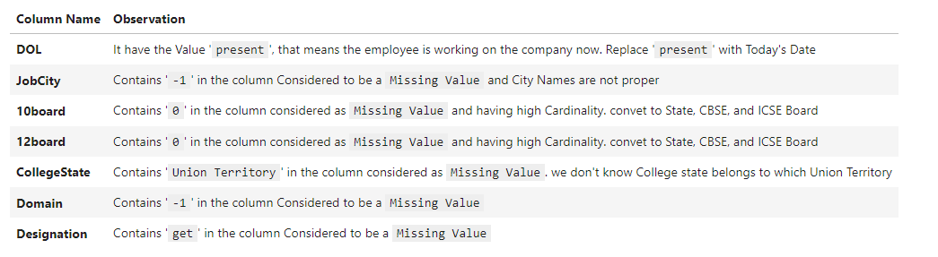

Data Cleaning:
After conducting preliminary assessments on the provided data, it has come to my attention that there are some irregularities present within the dataset.

Slide 9
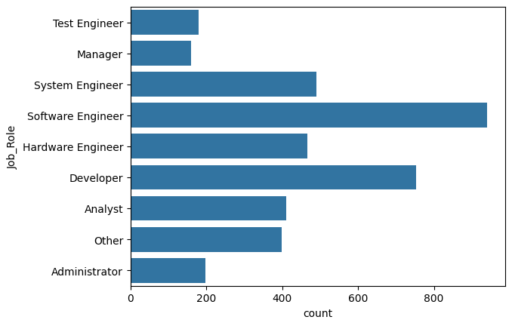
Univariate Analysis:
Moving forward, we'll use the Job_Role column derived from Designation column for deeper exploration and informed decisionmaking.
Following an analysis of the Designation column, I observed high cardinality, making analysis challenging.
Thus, I reclassified it into broader categories for easier interpretation.
The most prevalent roles are Software Engineer and Developer.
This adjustment allows for more structured analysis, providing insights into job role distributions and their impacts on various aspects like salary and performance.

Slide 10
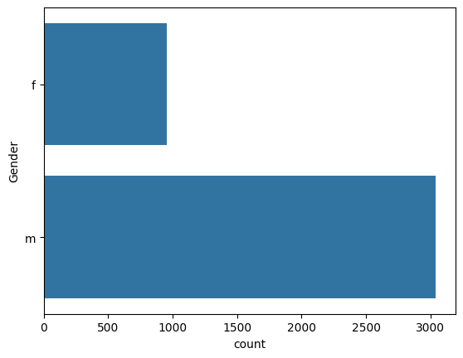
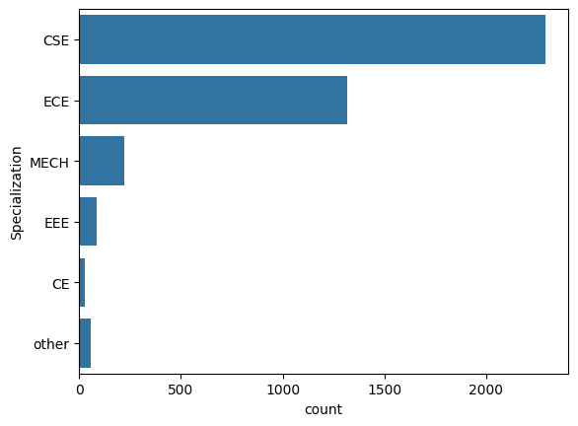
Analysis of the Gender column reveals a substantial gender gap, with a proportion of approximately 1 female for every 3 males.
This highlights the need for initiatives promoting gender diversity and inclusion in the workplace to ensure equal opportunities and representation.
Data suggests a prevalence in Computer Science and Engineering (CSE) specialization, followed by Electronics and Communication Engineering (ECE), Mechanical Engineering (MECH), Electrical and Electronics Engineering (EEE), and Civil Engineering (CE). These trends shape recruitment and curriculum strategies in the engineering sector.

Slide 11
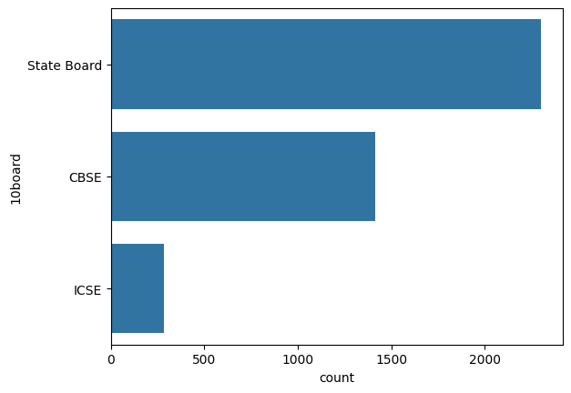
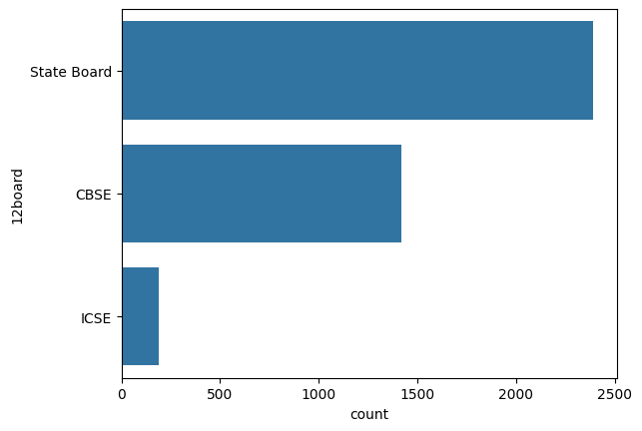
State Boards dominate as the preferred examination boards for both 10th and 12th grades than , CBSE and ICSE Boards.
These trends reflect a widespread preference among individuals surveyed.
Insights into board preferences inform educational policies and curriculum development to better serve diverse student backgrounds.

Slide 12
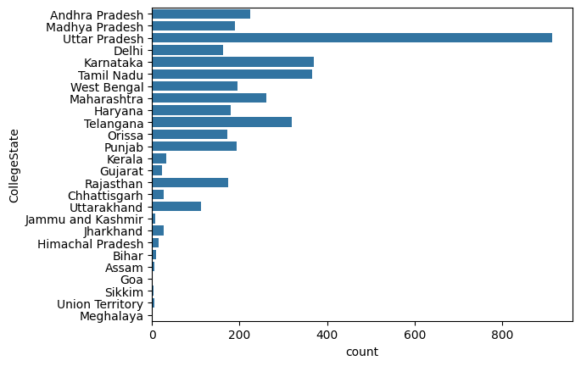
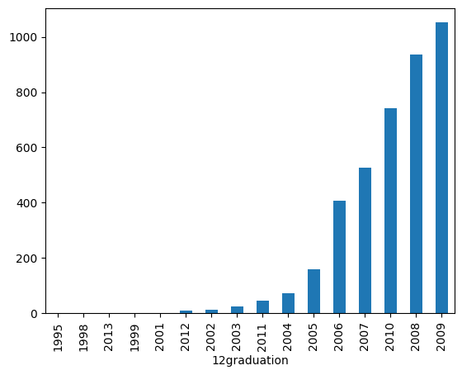
A significant majority, approximately 70%, completed their graduation between 2006 and 2009.
Colleges from Uttar Pradesh dominate, indicating a strong presence of graduates from this region.
Following Uttar Pradesh, Karnataka and Tamil Nadu are notable for their college representation.
Conversely, Meghalaya and Goa have fewer graduates, suggesting lower college participation rates.
These insights provide valuable guidance for educational planning and resource allocation across diverse regions.

Slide 13
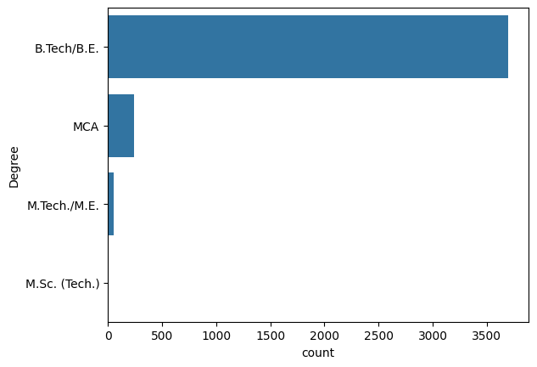
The predominant qualification among students is Bachelor of Technology/Engineering (B.Tech/B.E).
Following closely, Master of Computer Applications (MCA) emerges as the second most prevalent qualification.
These findings indicate a strong inclination towards technical fields among the surveyed individuals.
Insights into qualification preferences inform educational institutions and employers in tailoring programs and career opportunities to align with student aspirations.

Slide 14
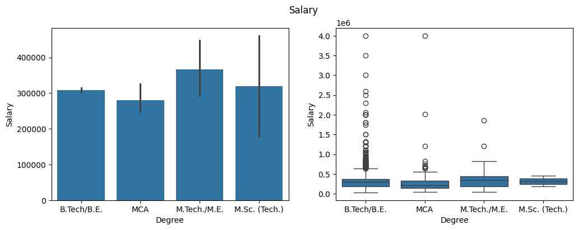
- Bivariate Analysis:
M.Tech/M.E graduates generally earn higher average salaries compared to others.
Despite this, B.Tech/B.E graduates have a greater likelihood of earning better than M.Tech/M.E graduates overall.
This suggests that while M.Tech/M.E qualifications may lead to higherpaying roles in some cases, B.Tech/B.E graduates enjoy a broader range of earning opportunities in the job market.

Slide 15
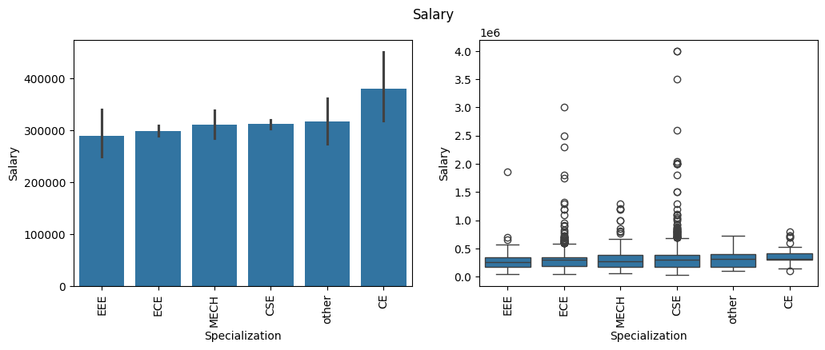
CSE graduates typically command higher salaries compared to their counterparts from other disciplines, indicating a strong demand for their skill set in the job market.
The majority of students surveyed are pursuing Bachelor of Technology/Engineering (B.Tech/B.E) degrees, with Master of Computer Applications (MCA) as the second most prevalent qualification.
These findings underscore the importance of technical expertise, particularly in computer science, for maximizing earning potential and career opportunities in today's job market.

Slide 16
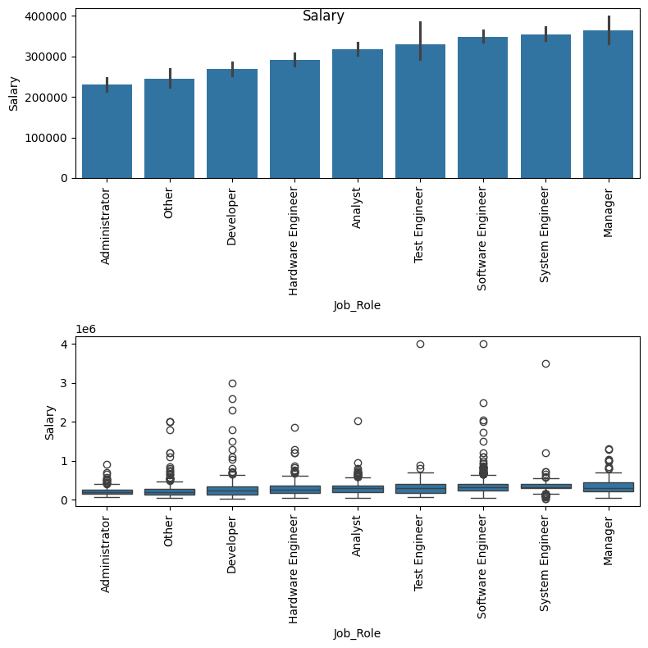
Managers emerge as the highest earners according to the graph, indicating the lucrative nature of managerial positions within the dataset.
Following closely, System Engineers represent the second highest earners, underscoring the significant earning potential associated with technical roles.
These observations emphasize the importance of both managerial and technical skills in achieving higher earning potential within the workforce.

Slide 17
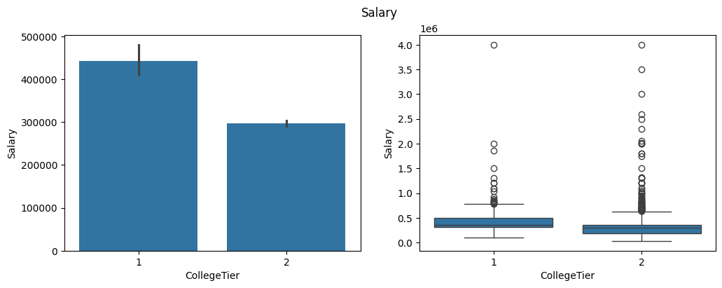
Individuals from Tier1 colleges exhibit higher earnings compared to their counterparts from Tier2 institutions, reflecting the perceived value and prestige associated with Tier1 educational institutions.
The data underscores the significant impact of college tier on earnings potential, highlighting the advantages afforded to graduates from Tier1 colleges in terms of career advancement and salary prospects.

Slide 18
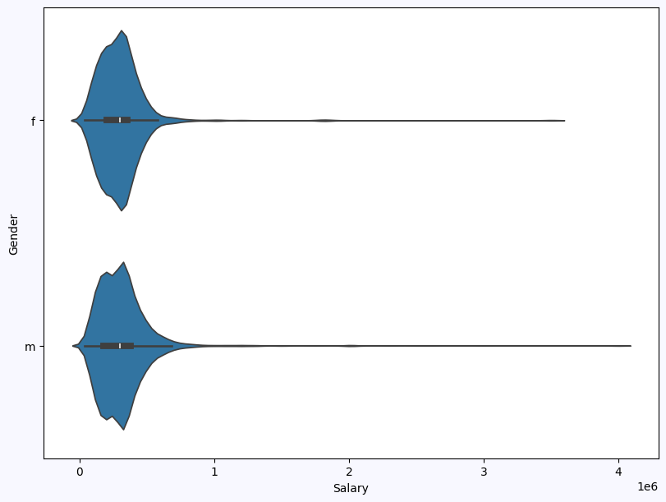
The observation reveals a subtle variance in median salary between female and male individuals, suggesting a potential gender disparity in earnings, although the extent of this difference remains uncertain.
While the difference in median salary appears minor, further analysis is required to determine the significance of this gap and to address any underlying factors contributing to potential genderbased discrepancies in earnings.

Slide 19
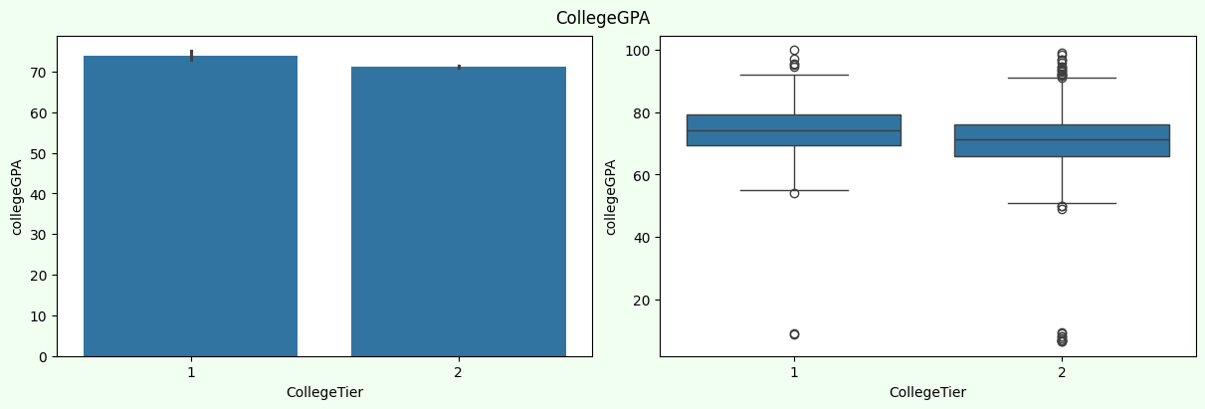
Students from Tier1 colleges exhibit slightly higher performance levels compared to those from Tier2 institutions, indicating a potential correlation between college tier and academic achievement.
This observation suggests that attending a Tier1 college may provide students with additional resources or opportunities that contribute to enhanced academic performance, highlighting the potential advantages associated with highertier educational institutions.

Slide 20
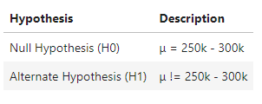
Research Questions
Times of India article dated Jan 18, 2019, states that “After doing your Computer Science Engineering if you take up jobs as a Programming Analyst, Software Engineer, Hardware Engineer and Associate Engineer you can earn up to 2.53 lakhs as a fresh graduate.” Test this claim with the data given to you.
Is there a relationship between gender and specialization? (i.e. Does the preference of Specialization depend on the Gender?)
Let's Verify the claim
Defining hypothesis

Slide 21
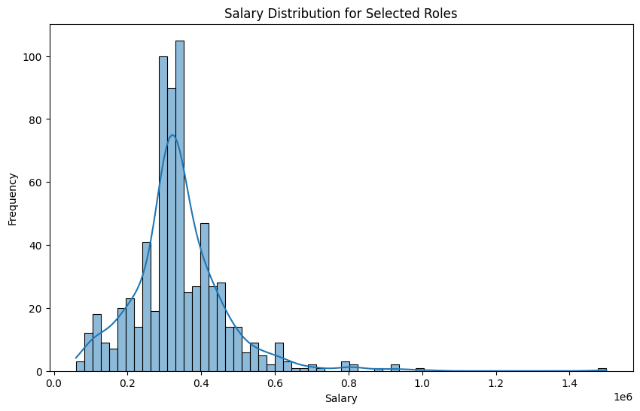
The data does not support the claim made in the Times of India article that fresh graduates in Computer Science Engineering can earn between 2.5 3 lakhs in roles such as Programming Analyst, Software Engineer, Hardware Engineer, and Associate Engineer.
There is no significant relationship between gender and specialization preference observed in the data, as the claim that gender influences specialization preference is not supported by the analysis.

Slide 22
Conclusions:
The data reveals a gender imbalance, indicating a need for diversity efforts in the workforce.
Technical skills, particularly in Computer Science and Engineering, are in high demand based on the prevalence of related degrees.
Job roles vary widely, with Software Engineer being the most common, followed by Developer.
Educational board preferences influence policies, with a preference for State Boards, CBSE, and ICSE.
Technical expertise is crucial, as evidenced by the prevalence of Bachelor of Technology/Engineering graduates.
Managerial and technical positions are the highest earning roles.
College tier impacts earnings, with Tier1 graduates earning more.
Gender based salary differences exist, though further analysis is needed for clarity.
The claim about recent graduates' earnings in Computer Science Engineering was not supported by the data.
There's no significant link between gender and specialization preference, challenging assumptions about their correlation.

Slide 23

THANK YOU !

